Slide 1





Parul Hackverse Team-ID: HV_057
Domain: Software (Open Innovation)
Team Name: Deciphers
Team Members:
Shailesh Agrawal
Pulkit Ashara
Mayur Bhamare
Tanishka Das

Slide 2

Problem Statement
Design a web app to eliminate communication barriers between speech and hearing-impaired individuals and non-impaired users. The app should provide real-time language translation, speech-to-text, text-to-speech, and sign language detection, ensuring accessibility in interviews and everyday interactions for a more inclusive and equal society.

Slide 3

Proposed Solution
choAssist
An Application that offers seamless real-time language translation for wide range of users
A Web App that uses AI, ML concepts for Real-time language translation, Hand sign detection, and communication between speech and hearing-impaired users.
The application uses Video Call (By creating a virtual room) technique for hand sign detection.
The web-app converts different languages as well as Speech to Text and vice versa, offers the hand Sign overlays.
Communication becomes easy by translating between different languages, including for candidates with impairments.

Slide 4

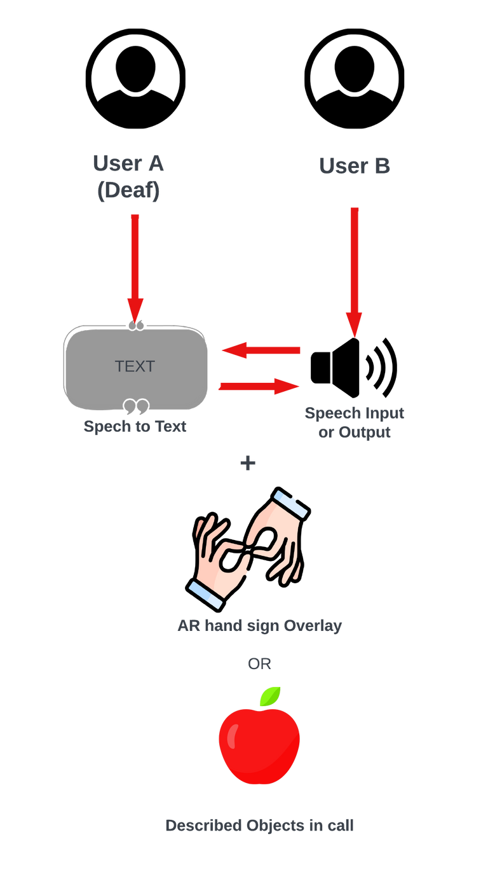

Hand Sign Animated overlays for seamless Understanding :
For Sign Language Users and illiterate Users.
Features and Innovations
Real-time translation between wide variety of languages
Also Speech to Text and Vice-versa
(Normal)
Multiple Language Support
For reliable and easy Communication.
Interview rounds for Normal & Speech-impaired candidates during Recruitment
Will support wide range of candidates
Fig .1: Diagrammatical of Echo assist.

Slide 5









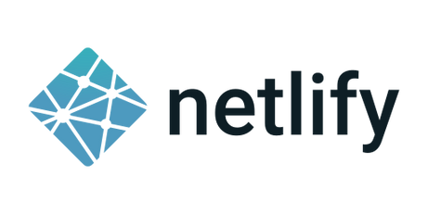



Core Technologies

Slide 6




Start
Login
Select type of user: Speech/Hearing imapired
Menu
Unique Meet Link/code
Place Voice/Video Call
System Workflow
Analyze the input data
Generate Captions/Signs accordingly
+
Virtual room
-
Generate and Save data
End
Fig.2 : Work flow of Echo assist

Slide 7





AI Models: Using Al image processing for translation and for transcribing video calls. BERT for Natural language processing & CNN for image classification.
Video/Voice call: Integrating features with calling APIs like WebRTC.
Speech-Text Conversion: Google Text to Speech APIs as affordable option.
Speech Translation: Google Translate API for translating languages in real-time.
Interviewing Platform: Unique codes for encryption, easy communication for speech/ hearing impaired candidates who seek jobs.
Methodology

Slide 8
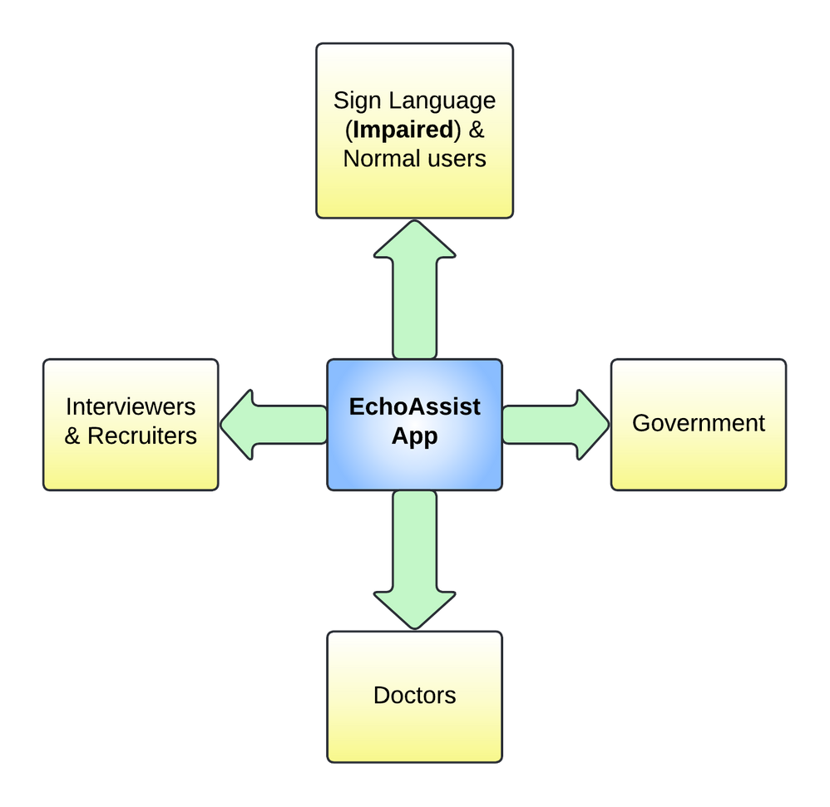
Impact and Benefits on Users
Facilitation of Employment Opportunities.
Support for Sign Language users as well as Normal Users can benefit wide range of people.
Reduction of Communication Barriers as it supports multiple language translation.
Increased Social Inclusion.
Psychological Benefits like Confidence boosting and reduction in anxiety.
Aids the complex recruitment process easier for Normal and even impaired candidates.
Patients can communicate with Doctors in mother tongue which system translates in user specified language.
Government can use this as a platform to connect with speech and hearing impaired laborers and farmers to address their problems online.
Fig : Applications

Slide 9




Future Scope and Conclusion
Future Scope
In conclusion, EchoAssist bridges communication gaps between speech and hearing-impaired individuals and others, fostering inclusivity through real-time language translation, AI-driven features, and seamless video call integration. It empowers users in everyday interactions and recruitment processes, ensuring accessibility and equal opportunities for all.
Offline Functionality
AR based hand signs

